Slide 1
PETRONAS Canada
Supplier Training for GEP and Enverus (OpenInvoice/OpenTicket)
Presentation to Suppliers
April 2023
Internal

Slide 2










Procure to Pay Overview
Contracting Process
Create Purchase Order
Acknowledge Purchase Order
Deliver Goods/ Perform Services
Create Field Ticket
Approve Field Ticket
Create Invoice
Approve Invoice
Payment
WHAT’S CHANGING / WHAT YOU NEED TO KNOW
1
Changes to the Contracting Process
How to register in GEP
How to Acknowledge Purchase Orders
4
Changes to the Field Ticket Process
Changes to the Invoicing Process
2
5
3

Slide 3





Procure to Pay Overview
Contracting Process
Create Purchase Order
Acknowledge Purchase Order
Deliver Goods/ Perform Services
Create Field Ticket
Approve Field Ticket
Create Invoice
Approve Invoice
Payment
WHAT’S CHANGING / WHAT YOU NEED TO KNOW
1
Changes to the Contracting Process
How to register in GEP
How to Acknowledge Purchase Orders
4
Changes to the Field Ticket Process
Changes to the Invoicing Process
2
5
3

Slide 4
PECL's Procure to Pay Digital Transformation

Slide 5
What is GEP Smart?
GEP SMART is a procurement software platform that is used by PETRONAS Canada (PECL) for
Purchase Orders – PECL will issue all POs to suppliers via GEP SMART
Contracts - PECL will collaborate with suppliers on GEP SMART for the negotiation, redlining, and execution of all contracts (Master Agreements, Statements of Work, etc.)
RFPs/RFQs – PECL will issue all sourcing events to suppliers/proponents via GEP SMART
Your registration process to GEP SMART only needs to happen once. After this step you can log in as needed, based on the sourcing event or task provided by PETRONAS Canada.
Note:
Enverus’ OpenInvoice and OpenTicket will continue to be used by PECL for supplier submission of Invoices and Field Tickets

Slide 6

PETRONAS Canada Contracting Approach
Supplier X
Collaboration via GEP Smart, execution/signature via Adobe Sign
Retains the general legal terms & conditions to enable repetitive business engagements typically set up on long-term basis (evergreen)​
Contract
(Master)
Term based to establish a preferred supplier status and retain the PriceBook, general commercial terms & conditions and service specific requirements​
Commercial Agreement #1
(SOW)
Commercial Agreement #2
(SOW)
Pricebook
Pricebook
Acknowledgement via GEP Smart
contain and relevant coding information and Specific call out instructions (in some less frequent cases can be issued without reference to a Contract or Commercial Agreement)​.
Typically the starting point for Invoice & Ticket submission ​
​
PO #1
PO #2
PO #3
PO #4
PO #5

Slide 7
How to Register in GEP

Slide 8
The Registration Process at a Glance
1. Receive Invitation eMail
2. Create Username/ Password
3. Log In
4. Update Profile for PECL
Basic Details
Identification Information
Location Information
Contacts

Slide 9

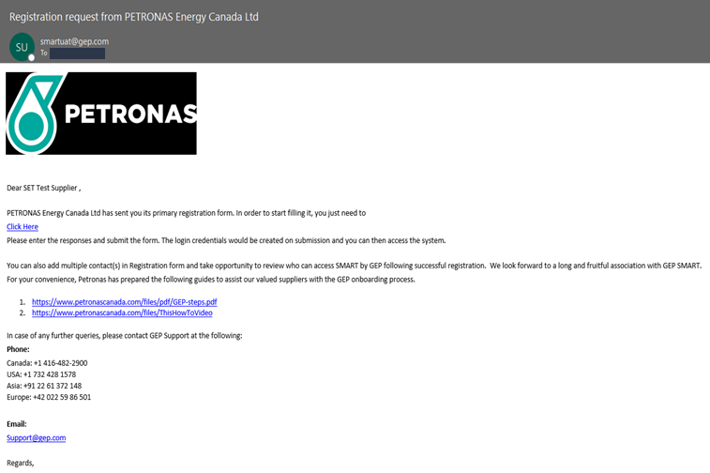



1. Receive Invitation eMail
2. Create Username/ Password
3. Log In
4. Update Profile for PECL
You will receive an email from support@gep.com with the email subject: Petronas Canada (PECL): Request for registration on GEP SMART
Note: Check your spam or junk email folder if you cannot locate it
Click on the “Click Here” link in the email and you will be routed to GEP Business Network registration page
The registration request email also contains links to GEP onboarding guides and to GEP Customer Support should you need additional support.
IMPORTANT:
Do not forward the invite to other contacts as the link is specific to you.
In case you would like any other team member from your company to register, please send an e-mail with the contact details to support@gep.com

Slide 10
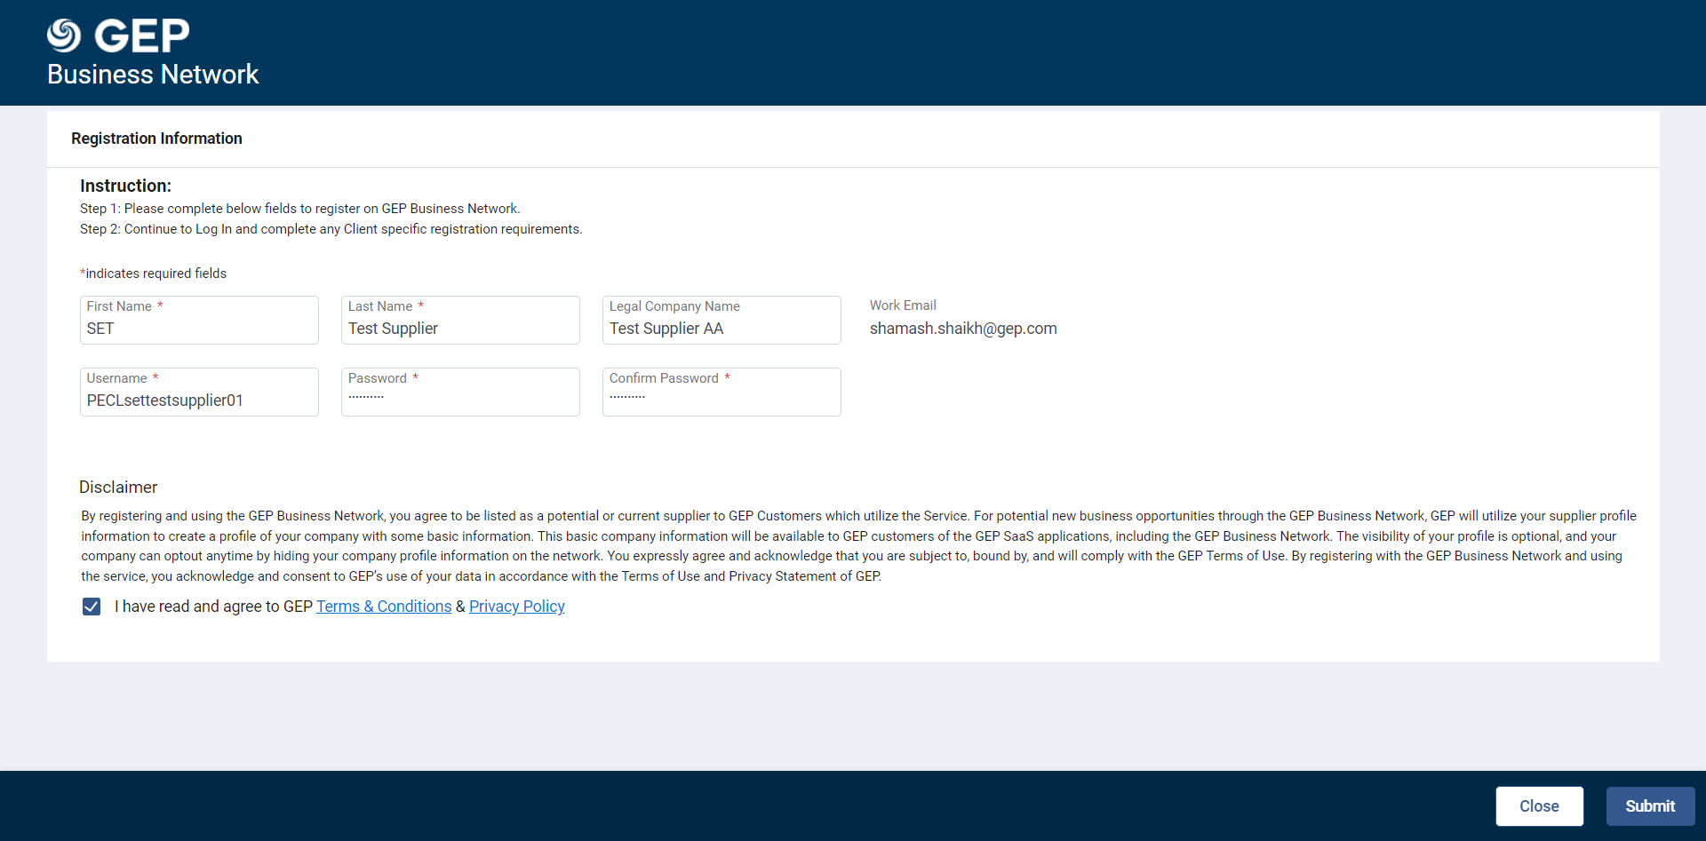
1. Receive Invitation eMail
2. Create Username/ Password
3. Log In
4. Update Profile for PECL
Existing GEP users:
Enter your existing GEP SMART credentials and then click Yes on the confirmation screen that follows.
New GEP users:
In the registration screen, enter the mandatory (*) details and create your USERNAME and PASSWORD. Enter the password again to confirm it.
Username guidelines: Username must be minimum 6 characters long, can be alphanumeric and contains no spaces. We recommend using your company email address.
Password guidelines: Password must be at least 10 characters long, contains at least 1 upper letter, 1 lower letter, 1 number and 1 special character ~!@#$%^&*()_+?
Select the checkbox to accept GEP’s Terms & Conditions & Privacy Policy in the lower left corner
Click the Submit button in the lower right corner. You will be re-directed to the GEP Business Network Login Page

Slide 11

1. Receive Invitation eMail
2. Create Username/ Password
3. Log In
4. Update Profile for PECL
Enter your Username created while registering
Click the Sign In button, to login to Business Network
Enter your Password created while registering
IMPORTANT:
Bookmark the link for future use (https://businessnetwork.gep.com)
Use Google Chrome or Microsoft Edge for best results. For any issues reach out to support@gep.com

Slide 12
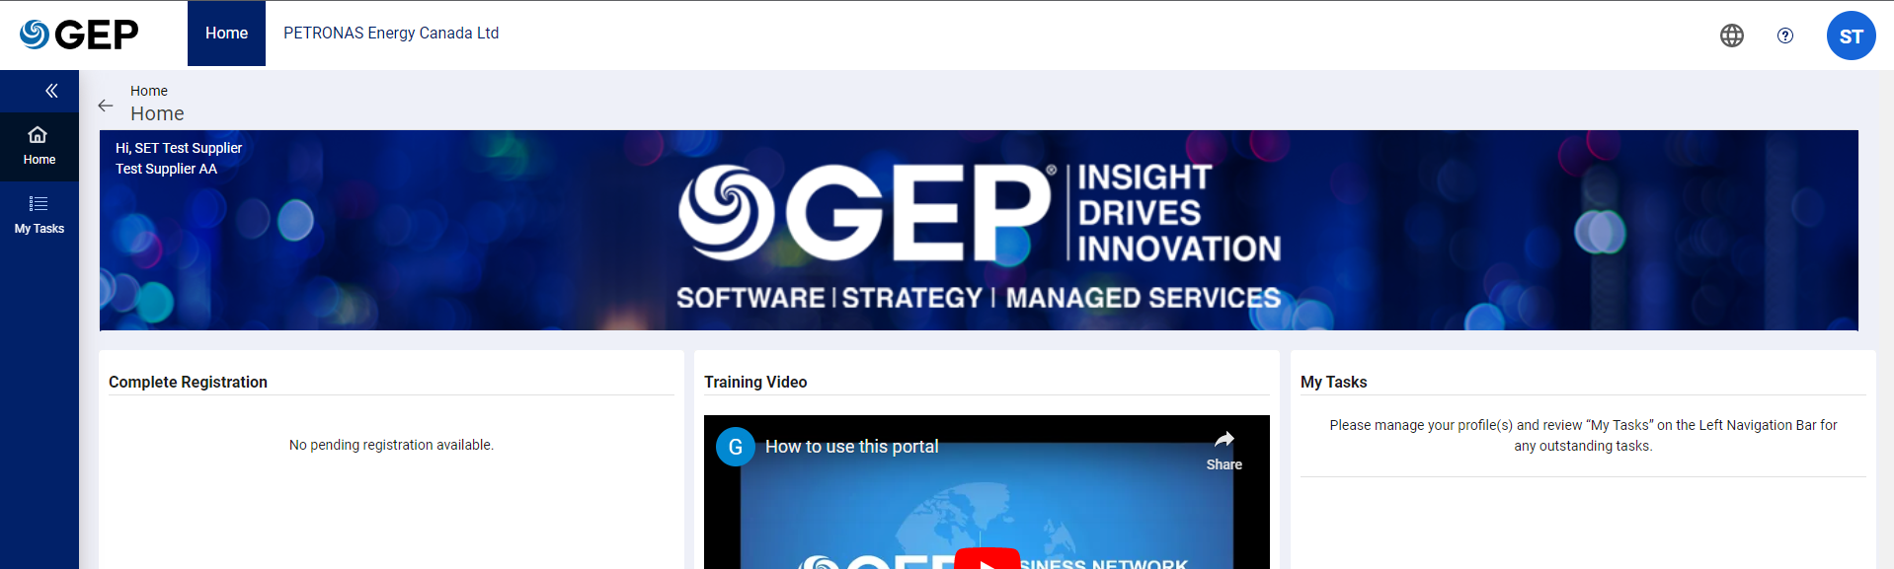
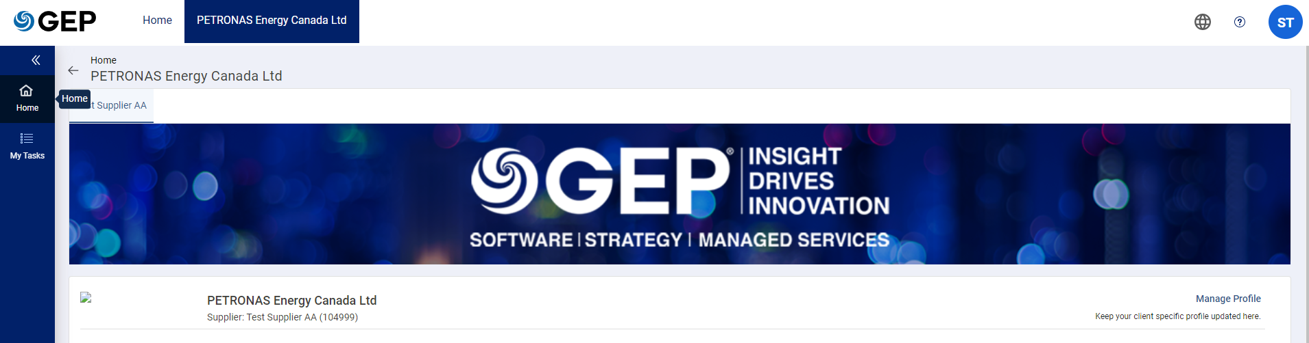
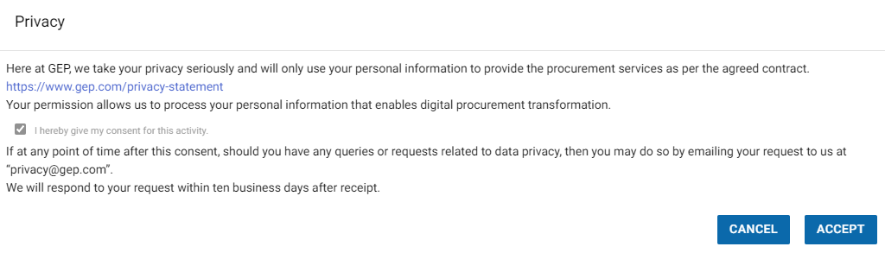
1. Receive Invitation eMail
2. Create Username/ Password
3. Log In
4. Update Profile for PECL
Click on “PETRONAS Energy Canada Ltd” from the top ribbon
Click Manage Profile
Review and Accept GEP’s Privacy Policy

Slide 13
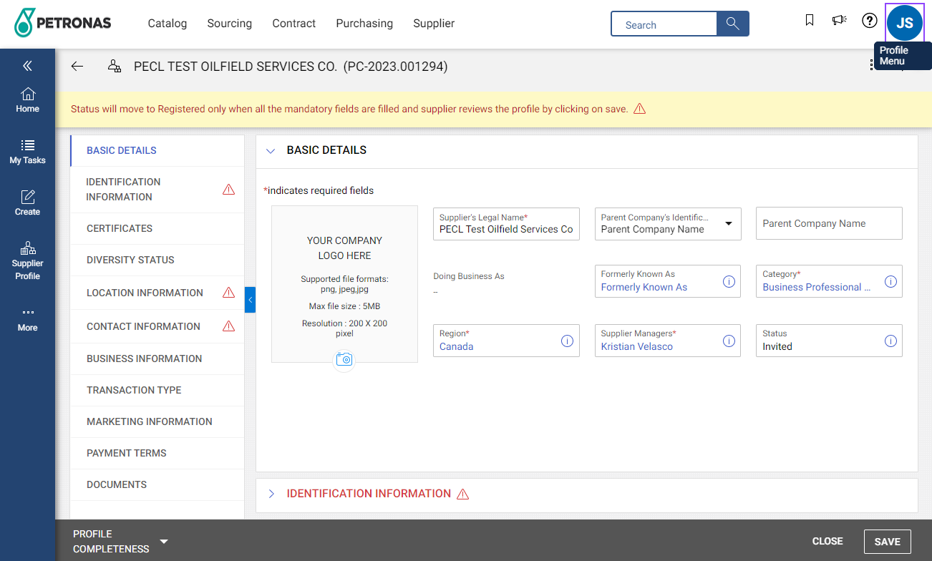

1. Receive Invitation eMail
2. Create Username/ Password
3. Log In
4. Update Profile for PECL
Basic Details
Identification Information
Location Information
Contacts
In the Basic Details section, please review/edit/enter details for the following fields:
Supplier Legal Name *
Parent Company Identification Type
Parent Company Name
Formally Known As
Region * (update only if needed)
Tip: By clicking the SAVE button after each section, not only do you validate that you have reviewed or entered the required fields, but it also improves the performance of the GEP Portal.
Tip: Mandatory information is denoted by RED TEXT, a red asterisk* next to the field name, or a red triangle next to the section name.

Slide 14
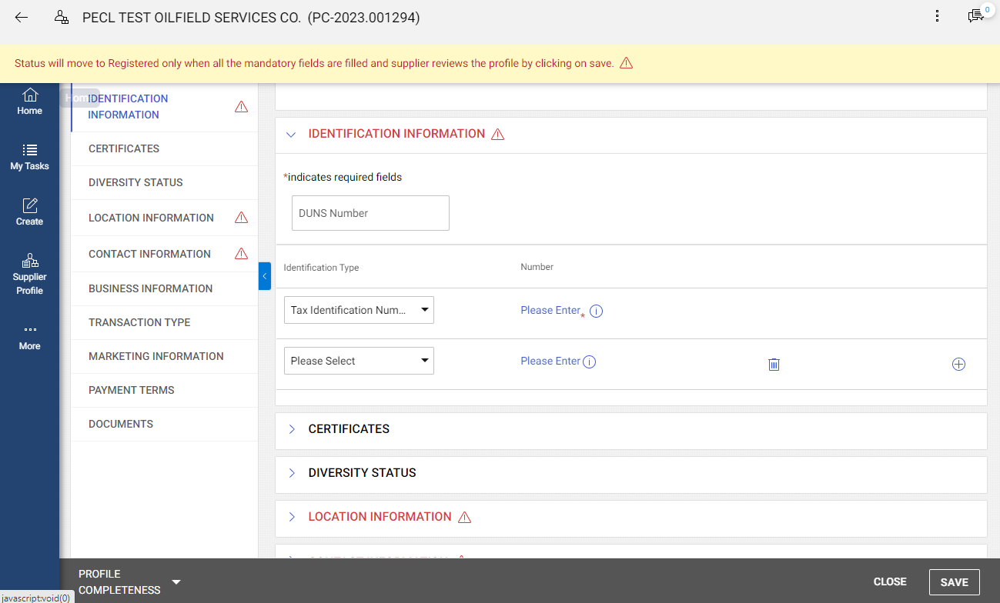

1. Receive Invitation eMail
2. Create Username/ Password
3. Log In
4. Update Profile for PECL
Basic Details
Identification Information
Location Information
Contacts
Scroll down and Expand the Identification Information Section.
Fill in the Tax Identification Number (GST) (mandatory)
For Canadian suppliers, only enter the 9 digit GST# that has been issued by Revenue Canada, with no spaces or dashes. Do not enter the ‘RT00x’ suffix.
If you are a non-Canadian entity, please enter your TaxID number in your country of origin (e.g. US EIN, UK VAT#, etc.)
Optionally, enter your company’s
DUNS Number
ISN Company ID
IMPORTANT: If you enter a GST number or DUNS ID that already exists in the GEP network, your company is already registered with GEP. In this scenario, contact support@gep.com. They will contact your company administrator and ensure the PECL invitation is tied to your existing company profile.
Click the SAVE button

Slide 15
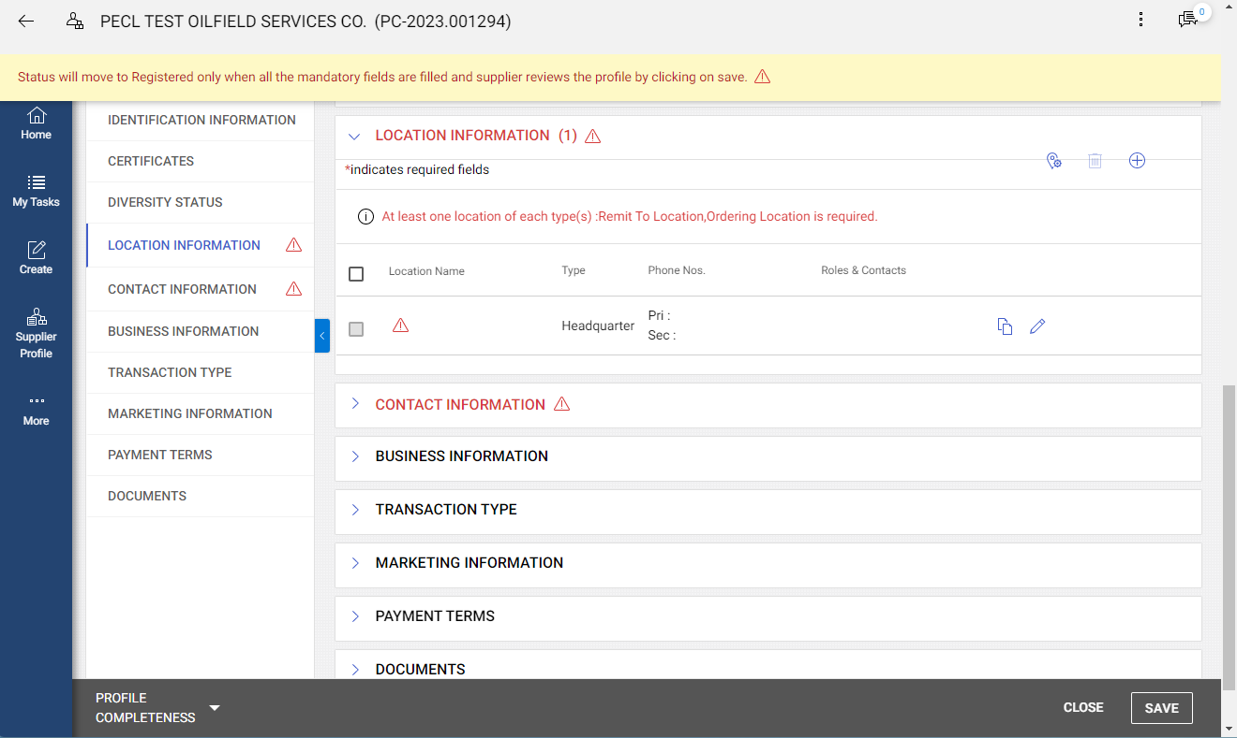
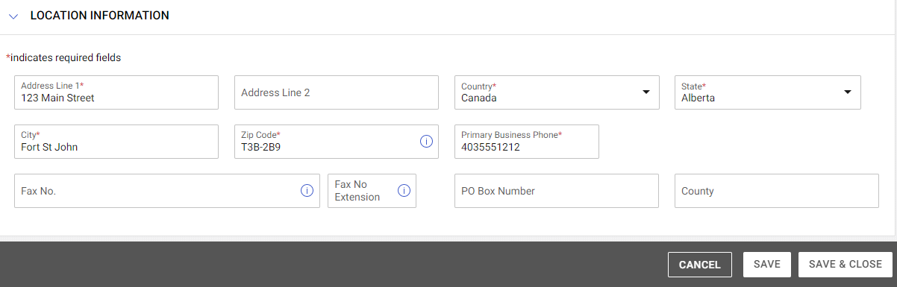
1. Receive Invitation eMail
2. Create Username/ Password
3. Log In
4. Update Profile for PECL
Basic Details
Identification Information
Location Information
Contacts
Scroll down and Expand the Location Information Section.
The default location to complete is Headquarter.
Click the Edit button
Fill in all Address information then click
SAVE AND CLOSE
Click the SAVE button
After completion of these steps, your Headquarter location is now complete. Two additional locations are required : Remit to Location and Ordering Location.

Slide 16

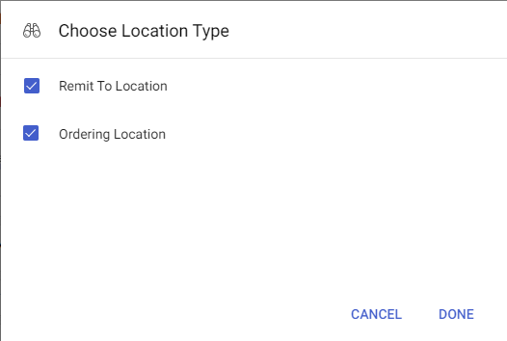
1. Receive Invitation eMail
2. Create Username/ Password
3. Log In
4. Update Profile for PECL
Basic Details
Identification Information
Location Information
Contacts
Method 1 – Copy your Headquarter Location
Click the Copy button.
Click DONE.
Click the SAVE button.

Slide 17




1. Receive Invitation eMail
2. Create Username/ Password
3. Log In
4. Update Profile for PECL
Basic Details
Identification Information
Location Information
Contacts
Method 1 – Copy your Headquarter Location
Click the Copy button.
Click DONE.
Click the SAVE button.
Method 2 – Create new Locations from Scratch
Click the Create button to add a location from Scratch
Fill in all Address information and click SAVE AND CLOSE
Click the SAVE button

Slide 18
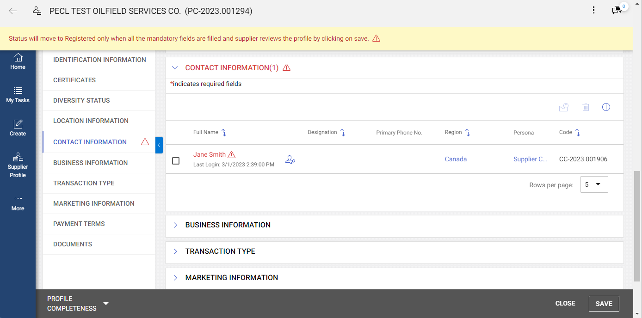
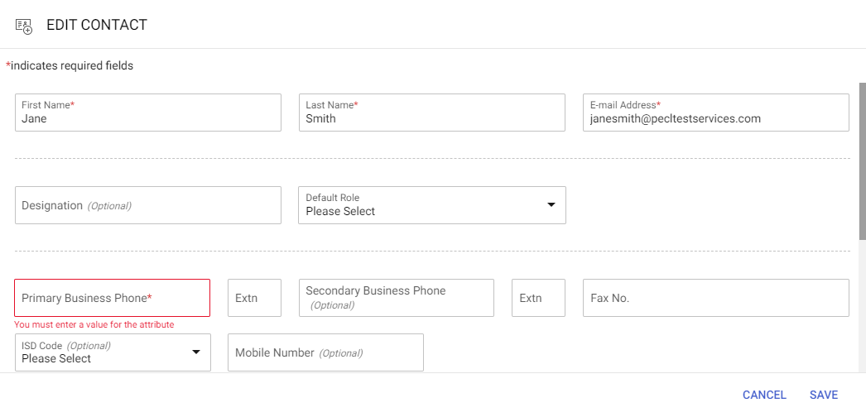
1. Receive Invitation eMail
2. Create Username/ Password
3. Log In
4. Update Profile for PECL
Basic Details
Identification Information
Location Information
Contacts
Scroll down and Expand the Contact Information Section.
Click the contact name to edit.
Verify all information, enter a primary phone number, verify timezone, and Save.
IMPORTANT - the timezone defaults to GMT. RFP response start and close times are displayed in the timezone of the user. If you want these to be displayed in your local timezone as opposed to GMT, please update this field.

Slide 19

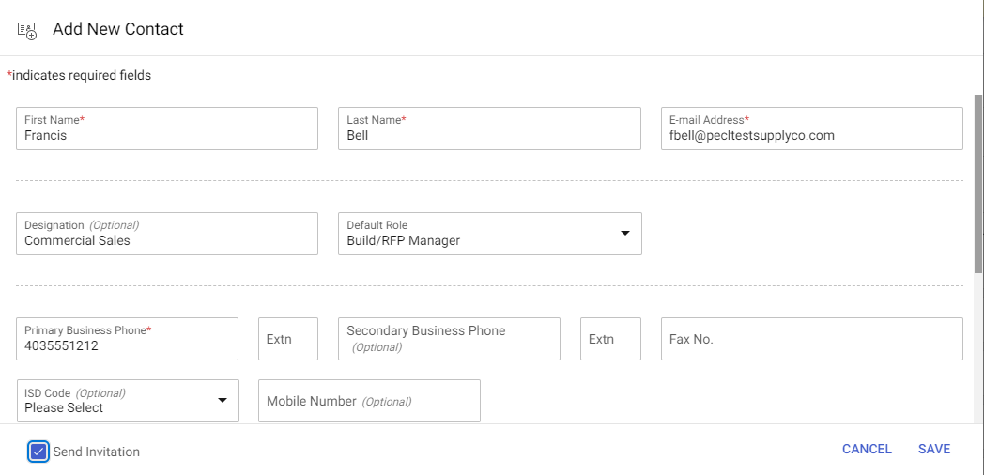
1. Receive Invitation eMail
2. Create Username/ Password
3. Log In
4. Update Profile for PECL
Basic Details
Identification Information
Location Information
Contacts
To add a new contact, click the Add button.
Fill in all data. Default Role is optional but will help PECL in identifying appropriate people from your company for routing of RFPs, Purchase Orders, and Contracts. Check the Send Invitation checkbox (other users will not need to go through this entire registration process, they will just need to create their usernames and passwords). Scroll down to adjust the user’s Timezone. This defaults to GMT and should be adjusted.
SAVE the contact.
Click the SAVE button

Slide 20
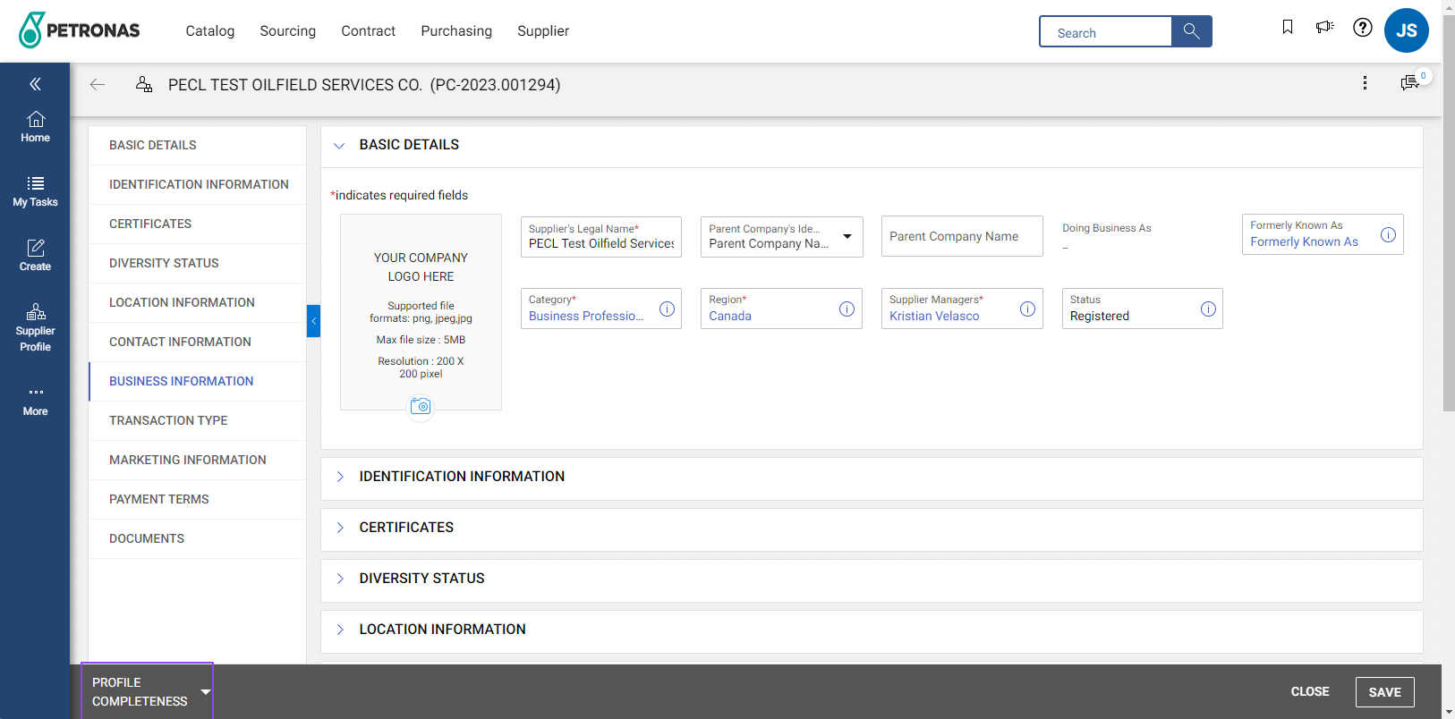
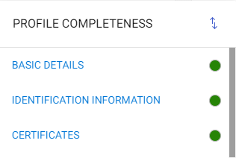
When all mandatory information is filled in, there should be no more red triangles I in the side bar.
Click the PROFILE COMPLETENESS dropdown to ensure all profile requirements are satisfied. All sections should show green alerts.
Click the SAVE button
YOU’RE DONE!
Your company profile will now be routed to the PECL Supplier Manager for approval.
Approval may take several days, but you will receive a notification when your profile has been approved.
Your organization will now be able to participate in sourcing events, contract collaboration, and purchasing through GEP!

Slide 21
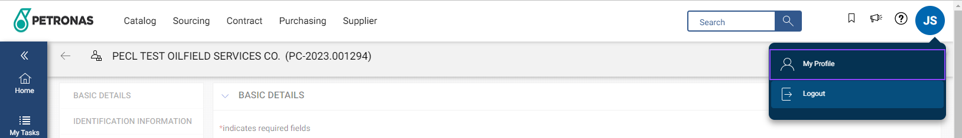
Ensure to log out of GEP while not actively using it. At the top right hand corner, click your Profile Menu (your user initials), and then click Logout. You will be redirected to the GEP Business Network sign in page.
Support & Assistance
Should you have any questions related to the GEP SMART application, please contact GEP Support:
Email:
support@gep.com
Phone:
Canada: +1 416-482-2900
USA: +1 732 428 1578
Asia: +91 22 61 372 148
Europe: +42 022 59 86 501

Slide 22
How to Acknowledge Purchase Orders

Slide 23
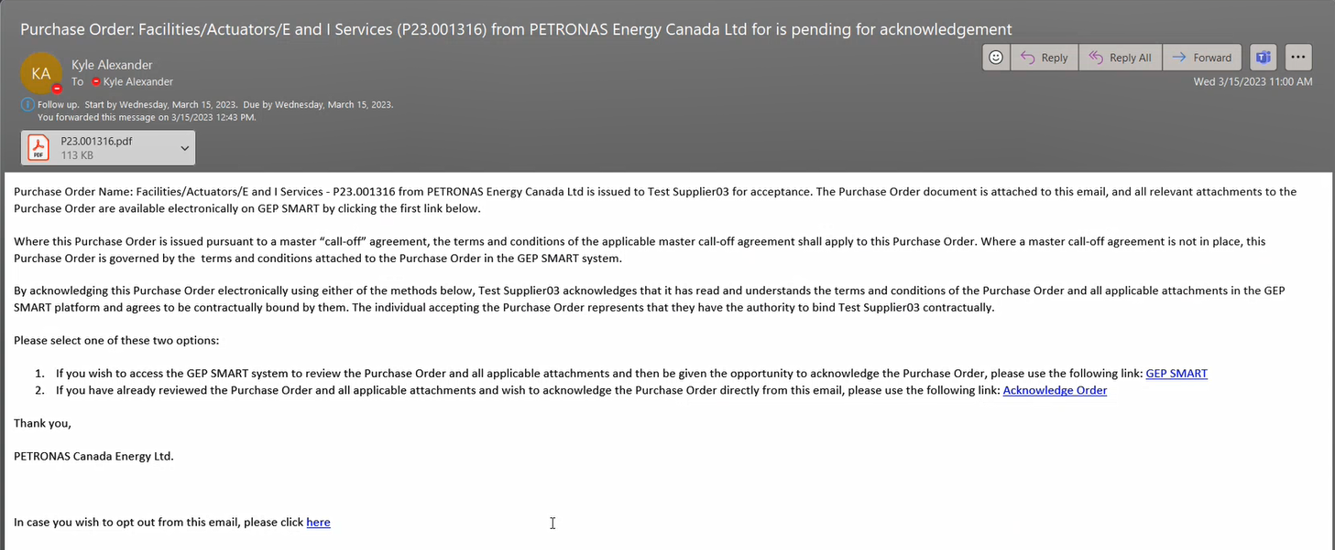
PO Acknowledgement – from eMail
Your designated order contact will receive a copy of the PO via eMail as soon as it is released (or changed).
You can acknowledge the PO directly from links in the email, or you can log in to GEP and acknowledge it there (PO attachments will not be included in the email)
If there are problems with the PO (e.g. can’t meet the delivery date), please contact the Purchaser identified on the PO
A PDF copy of the PO is attached. Open to review.
Click to Log In to GEP to review the PO (Optional, but recommended if you expect other attachments such as maps, diagrams, engineering drawings, etc.)
Click to Acknowledge Order

Slide 24
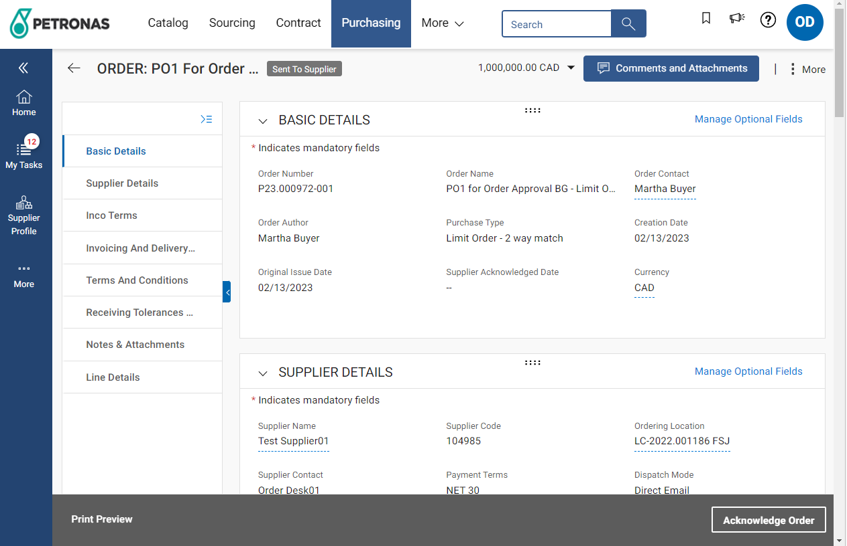
PO Acknowledgement – in GEP
If this is a Change Order, you can Review Changes or view the Change History by clicking the ‘More’ button
If you expect any attachments (diagrams, maps, specifications, etc.) to your purchase orders, these are not included in the email. Please log in to GEP to view the PO attachments prior to acknowledging the PO.
If you see a number next to My Tasks, you have new documents requiring your action. Click My Tasks, then Action Pending, then select a PO to open and review
If you would like to request any changes to the PO, please email the Order Contact noted in the PO.
Review all sections of the Purchase Order, paying particular attention to any Attachments
Click to Acknowledge Order

Slide 25
Purchase Order Types
Limit Order
e.g.
“Construct the Processing Unit per attached diagrams/specification”
1 AU @ $1,000,000 over 1 year
Detailed Order
e.g.
5 ea Safety Goggles at $10
5 ea Nomex Coveralls at $100
Term | Typically longer term | Aligned to specified projects
What you need to know | PETRONAS Canada is ordering the overall project result. The details of how this result is achieved will be provided by you, the supplier, in your field tickets and invoices. | PETRONAS Canada is ordering specific products or services, in specific quantities
How was the budget/pricing calculated? | The budget will have been developed via collaboration between your sales/planning reps and PECL’s supply chain/field reps. We expect suppliers to stay within their planned budgets unless there are extenuating circumstances. | Pricing will have been derived from your contracted prices with PECL
Validations on Field Tickets and Invoices | The system will not let you exceed the overall budget on the aggregate of field tickets and invoices. | The system will not let you exceed the unit prices or quantities, change the units of measure, nor add line items
What about variances? | If there are extenuating circumstances, please discuss with your PECL field reps in advance of hitting the overall limit. | Unplanned freight/shipping charges can be supported

Slide 26


Procure to Pay Overview
Contracting Process
Create Purchase Order
Acknowledge Purchase Order
Deliver Goods/ Perform Services
Create Field Ticket
Approve Field Ticket
Create Invoice
Approve Invoice
Payment
WHAT’S CHANGING / WHAT YOU NEED TO KNOW
1
Changes to the Contracting Process
How to register in GEP
How to Acknowledge Purchase Orders
4
Changes to the Field Ticket Process
Changes to the Invoicing Process
2
5
3

Slide 27
Enverus (OpenTicket & OpenInvoice) Changes

Slide 28
Terminology and Department Changes
Old Term | New Term
AFE (Authorization for Expenditure) Cost Center | Cost Object | New Cost Object Types: AFE = WBS (Work Breakdown Structure) Cost Center Work Order/Internal Order
Major/Minor/Subcode | GL Account
IMPORTANT: if you have both a cost center # and a work order # provided to you by your PECL field rep, always use the work order # in Enverus. Also if you are provided a work order #, but conduct work at a site where you know the cost center number, always use the work order # for invoicing & ticketing
IMPORTANT: With this transformation, PETRONAS Canada will be converting all out main Coding elements to new coding numbers:
AFEs will become WBS's with a new number assigned
Costs Centers will still remain Cost Centers however will have a new number
Major.Minor codes will become GL numbers, with new numbers
Work Orders now are a number that can have costs charged against it
The cross reference of old numbers to new numbers has been provided via email from SCM@petronascanada.com as well as will be posted in Enverus' Resource Center (click the Help (question mark) link at the top right of Enverus, then ‘My Company Documents’, then select PETRONAS Energy Canada Ltd. as the buyer).
Remit to Department Changes
Old Department Name | New Name
Information Technology | Digital Technology Services
Fort St John | Production and Field Operations
Health and Safety (HSSE) | Health, Safety and Security

Slide 29
Changes to the Field Ticketing Process
(if you are using OpenTicket for electronic Field Ticket submission)

Slide 30
Field Ticket Changes
WHAT’S CHANGING / WHAT YOU NEED TO KNOW
1
Always search for your PO first, then ‘Flip’ from the PO into your Field Ticket
  This ensures the correct PO, PO Line, Contract #, GL Code, and Cost Object are applied to your field ticket. It saves you work and prevents errors.
  See PO description for original Price Book number/description to help identify the correct PO for billing.
2
PECL requests all tickets be submitted within 48 hours after work is performed in the field
  Timely ticket submissions can be approved more quickly. Late ticket submissions may result in delays to the timeliness of your ability to invoice and get paid.
3
PECL uses standardized Units of Measure. These are in ALL CAPS and follow ISO standards
  Examples:. HR, DAY, FT, EA
  A full list is included in the appendix, and available on Enverus in the Support Center at any time
4
Field Tickets cannot be invoiced until after they are approved
5
PECL Coding is required at time of ticket submission
  Tickets submitted via OpenTicket will require assignment of a Work Order, Cost Center or WBS
6
Field Tickets cannot be invoiced more than once
  A field ticket may be partially invoiced, in which case the balance may still be invoiced later

Slide 31
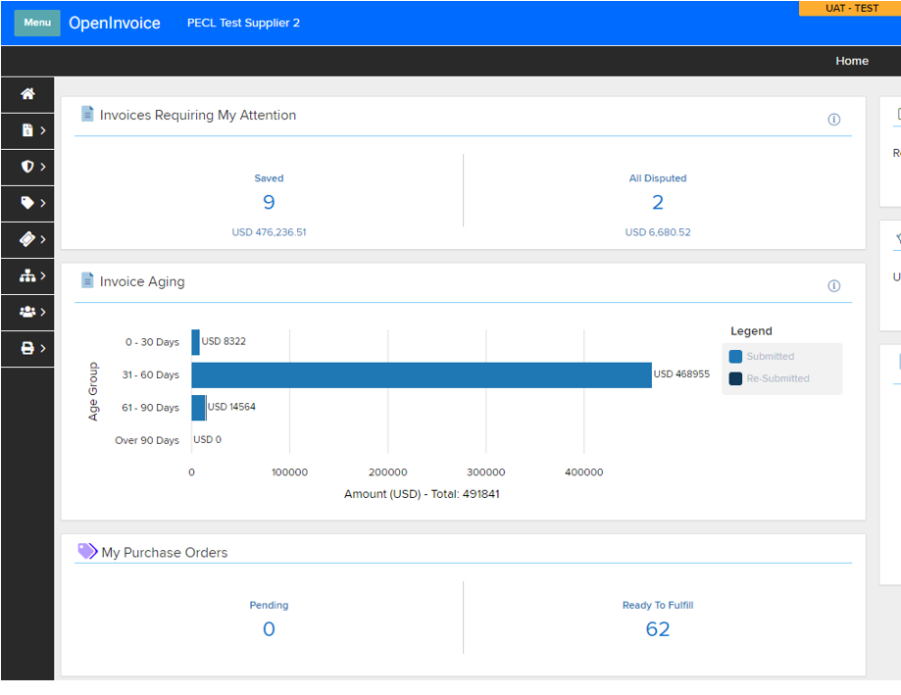

Finding your PO on Enverus
You can search for purchase orders ready to fulfill by clicking the Order button.
From the My Purchase Orders section on your homepage, click the Ready to Fulfill tab to view purchase orders assigned to you.

Slide 32
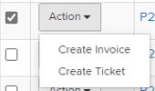
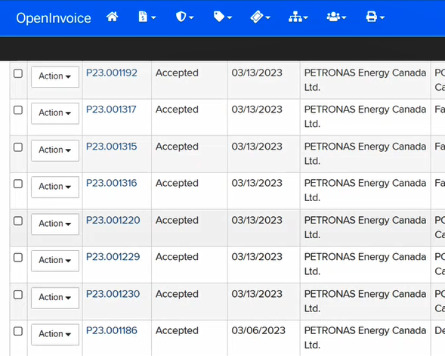
Creating a Ticket from the PO List
Tips:
Apply a filter to the list to narrow results. Your PETRONAS Purchase Orders in OpenInvoice will have an Order Status of Accepted.
Tips:
Avoid using the top ribbon for creating a field ticket directly (without flipping from PO), as not all PO fields transfer, increasing the chance for error
You can create a ticket directly from the PO list page. Click the Action button, then select the Create Ticket dropdown option.

Slide 33
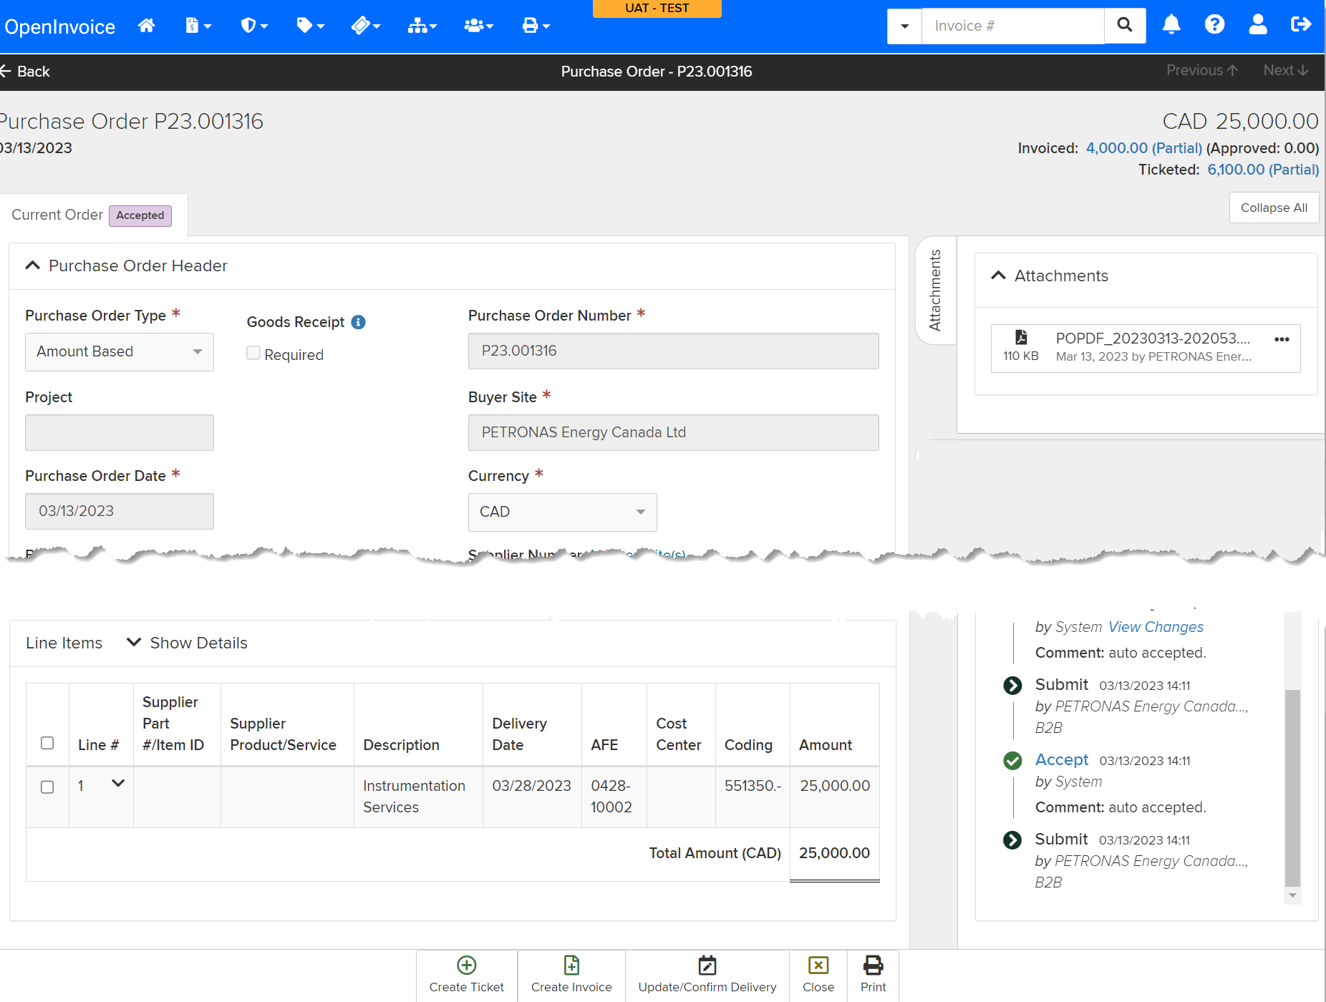
Creating a Ticket from the PO Details
The attachment is the same as the one in the acknowledgement email.
If you would like to review the details of the PO before flipping to a ticket (particularly useful for detailed orders), open the PO from the list page.
Scroll down to the Line Items section
Select the lines that will be flipped to a purchase order
Click Create Ticket

Slide 34
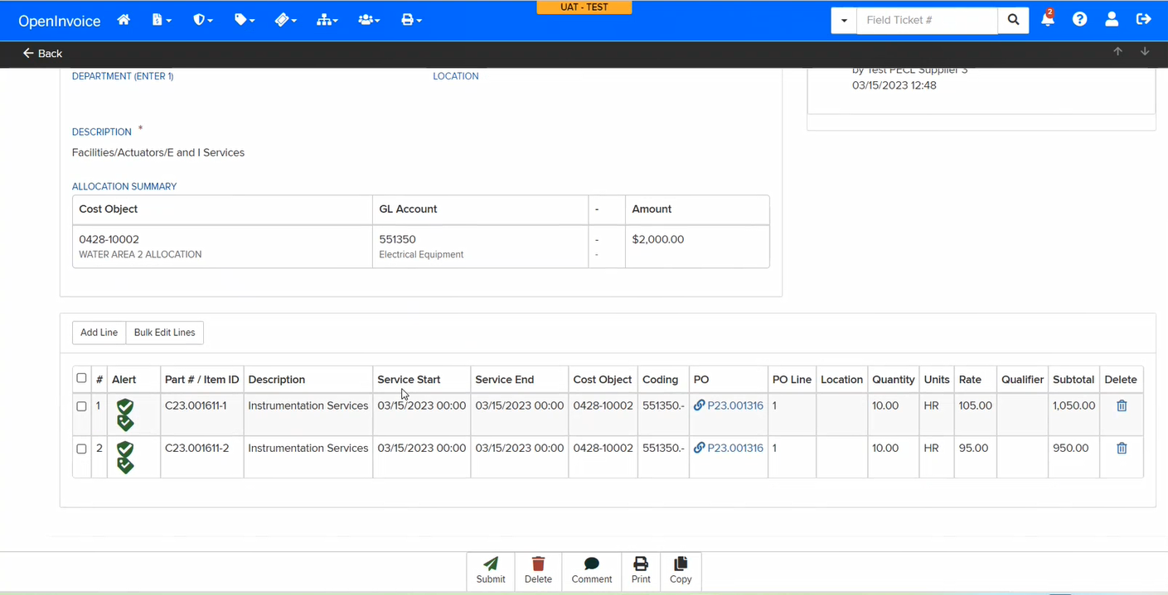




Field Ticket Alerts
PO Alerts | Compliant
 | Multiple Orders Quantity Exceeded Rate Difference Price Book Mismatch External Order Limit Exceeded Tolerance Warning Service Mismatch
 | Coding Mismatch Units Mismatch Requisitioner Mismatch
Pricebook Alerts | Compliant
 | Currency Mismatch Above Price Book Rate
 | Below Price Book Rate Price Book Rate Unspecified
 | Off Price Book
Alerts indicate if field ticket is compliant with the Contract/Pricebook and the PO.
Red alerts will cause your ticket to be rejected
Ideally we want to see green alerts on tickets

Slide 35
Changes to the Invoicing Process

Slide 36
Invoicing Changes
WHAT’S CHANGING / WHAT YOU NEED TO KNOW
1
Always search for your PO first, then ‘Flip’ from the PO into your Invoice
  This ensures the correct PO, PO Line, Contract #, GL Code, and Cost Object are applied to your Invoice.
  It saves you work and prevents errors.
  See PO description for original Price Book number/description to help identify the correct PO for billing.
2
If you use OpenTicket (electronic tickets), always ‘Flip’ from approved tickets into your Invoice
  If there are extra charges on your invoice not covered by an electronic ticket, ensure to submit a supplemental ticket to get these charges approved
3
PECL uses standardized Units of Measure. These are in ALL CAPS and follow ISO standards
  Examples:. HR, DAY, FT, EA
  A full list is included in the appendix, and available on Enverus in the Support Center at any time
4
You cannot invoice for more than the overall value of a limit order
5
If you are referencing a detailed order, you cannot exceed the quantities and rates specified on the order

Slide 37
Finding your PO on Enverus
You can search for purchase orders ready to fulfill by clicking the Order button.
From the My Purchase Orders section on your homepage, click the Ready to Fulfill tab to view purchase orders assigned to you.

Slide 38
Creating an Invoice from the PO List
Tips:
Apply a filter to the list to narrow results. Your PETRONAS Purchase Orders in OpenInvoice will have an Order Status of Accepted.
Tips:
Avoid using the top ribbon for creating an invoice from scratch (without flipping from PO). Not all data fields from the PO transfer, increasing the chance for error
You can create an invoice directly from the PO list page. Click the Action button, then select the Create Invoice dropdown option.

Slide 39
Creating an Invoice from the PO Details
If you would like to review the details of the PO before flipping to an invoice (particularly useful for detailed orders), open the PO from the list page.
Scroll down to the Line Items section
Select the lines that will be flipped to a purchase order
Click Invoice

Slide 40
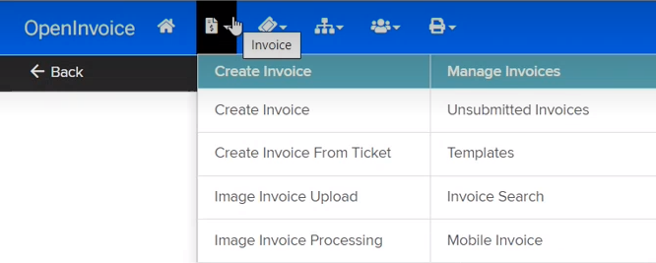
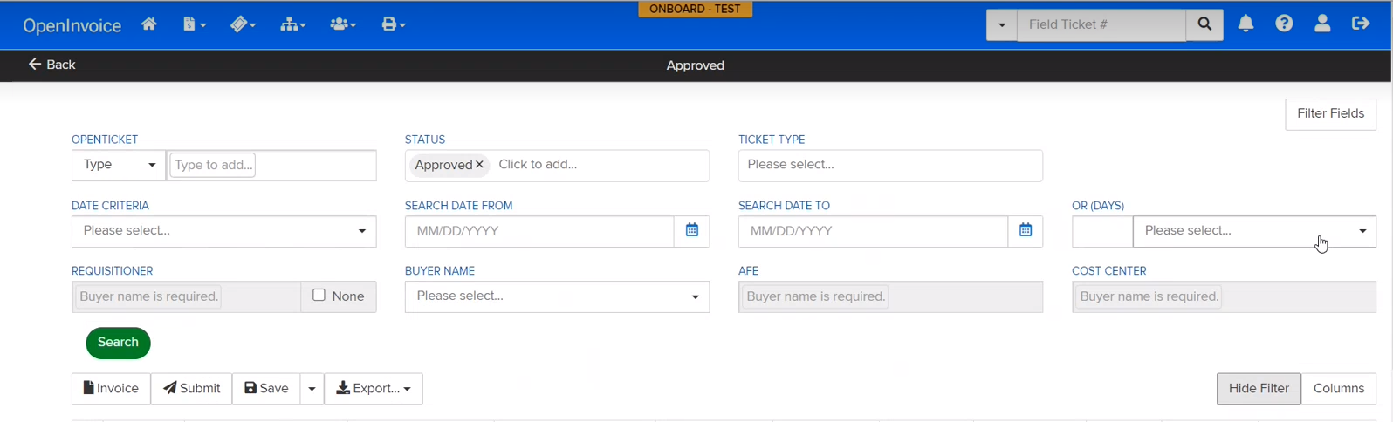
Creating an Invoice from Field Tickets
If your field tickets already reference a PO, you may flip approved, uninvoiced tickets into an invoice. You may also combine multiple field tickets into a single invoice, provided the reference the same PO and the same Superintendent/Department
From the top ribbon, select Create Invoice --> Create Invoice From Ticket.
Filter tickets
For the STATUS field, select Approved
Other filters for invoicing include Date From, Date To, and Requisitioner fields.
Click Search.

Slide 41
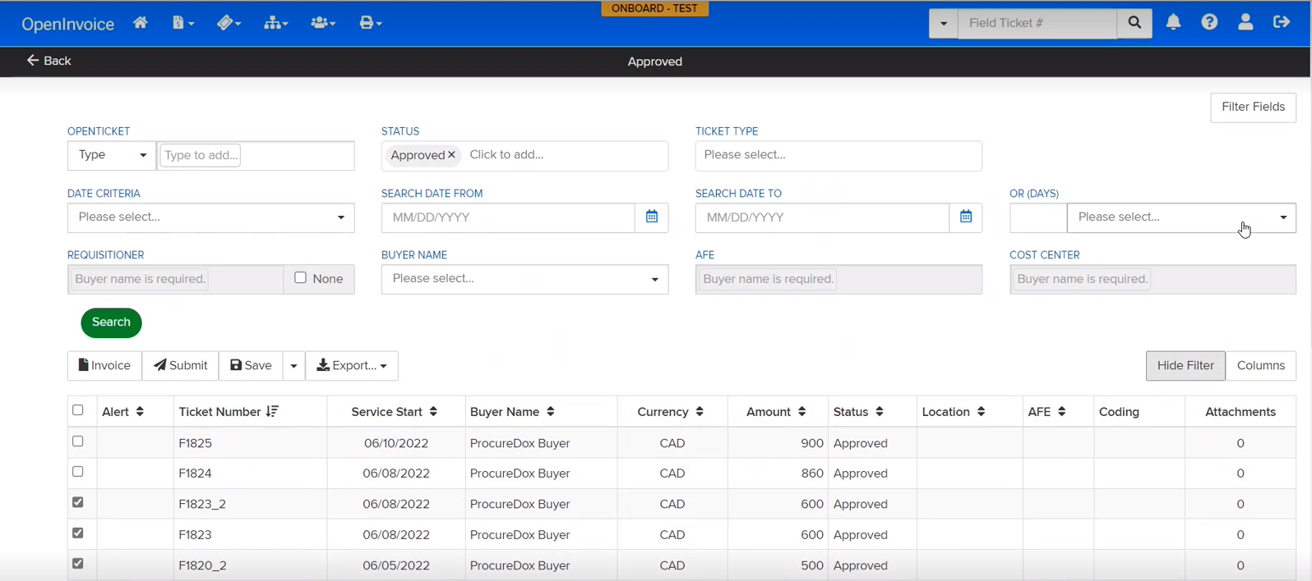
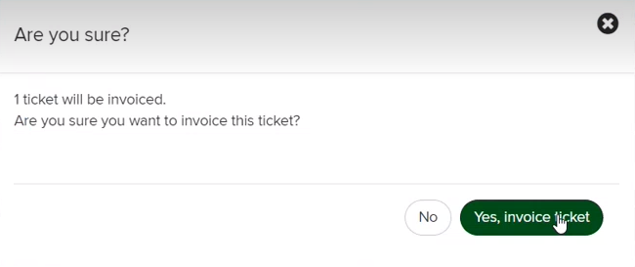
Creating an Invoice from Field Tickets
Select the tickets to be submitted for invoicing​.
Click the Invoice button.
On the pop-up screen, click Yes, Invoice Ticket.

Slide 42


Invoice Alerts
PO Alerts | Compliant
 | Multiple Orders Quantity Exceeded Rate Difference Price Book Mismatch External Order Limit Exceeded Tolerance Warning Service Mismatch
 | Coding Mismatch Units Mismatch Requisitioner Mismatch
Pricebook Alerts | Compliant
 | Currency Mismatch Above Price Book Rate
 | Below Price Book Rate Price Book Rate Unspecified
 | Off Price Book
Ticket Alerts | Compliant
 | Currency Mismatch Line-Item Mismatch
Alerts indicate if the invoice is compliant with the Contract/Pricebook and the PO.
Red alerts will cause your invoice to be rejected
Ideally we want to see green alerts on invoices

Slide 43
Common Gotchya’s
Invoice Date
  Please ensure that the “Invoice Date” entered in OI matches the date from your financial system or ERP.
  Prior to May 1, PETRONAS had requested that the “Invoice Date” reflect the invoice was submitted into OI.
Purchase Order (PO) error message
  Should you receive the error, “Pricebook must be derived from the PO. Please enter a valid PO Number. If this work is non-PO related, please choose 'N/A - Pricebook not applicable' in the price book drop-down.”:
    Always search for a valid PO in Enverus first. If you have one, flip that into an invoice (or electronic ticket, if applicable) instead of drafting an invoice (or ticket) from scratch.
    If you don’t have a valid (current) PO that is applicable for the work you are doing:
      Leave the PO # blank - and -
      Under Pricebook select “N/A – Price book not applicable”
Units of Measure
  PETRONAS is now validating Units of Measure.
  Please ensure you search for and use valid all units. If you receive an error (often indicated as “Invalid Units”), it’s possible that your invoice could still be pointing to an old Pricebook with invalid units, or your Enverus catalog.
  Changing units from pre-May 1 Field Ticket to a post-May 1 Invoice is allowed – it may cause a “yellow alert” in the system, but this is okay while we transition to new processes.

Slide 44
Common Gotchya’s
New financial coding
  PETRONAS has all new WBS (formerly AFE) codes, Cost Centers, and GL Accounts as of May 1, 2023.
  We have a published a cross- reference spreadsheet to the Enverus Resource Center and the PETRONAS Canada Corporate website, to help you look up the new numbers.
  Changing coding from a pre- May 1st Field Ticket to a post- May 1st Invoice is allowed – it may cause a “yellow alert” in the system, but this is okay while we transition to new processes
General Ledger Account entry
  When entering an Account code (ex. 551240), be sure to tab to the second box (minor account field) and enter a dash (-) character.

Slide 45
How to Get Additional Help
Support & Assistance
Should you have any questions, please contact :
Enverus Support:
  Email:
  openinvoicesupport@enverus.com
  Phone: +1 866-627-3287
GEP Support:
  Email:
  support@gep.com
  Phone:
  Canada: +1 416-482-2900
  USA: +1 732 428 1578
PETRONAS Accounts Payable Support:
  Email:
  Accountspayable@petronascanada.com
PETRONAS Supply Chain Support:
  Email:
  scm@petronascanada.com
To register for OpenInvoice: https://www.openinvoice.com/docp/public/registerBuyerText/. Creating an account is free and quick to register.
To register for GEP SMART, email evendor@petronascanada.com to request an invitation.

Slide 46
Appendix
Internal

Slide 47
Units of Measure
The following are the ISO (International Standards Organization) Units of Measure that PECL will support. If there are other units of measure you would like added, please contact evendor@petronascanada.com.
Code | Description |  | Code | Description |  | Code | Description
% | Percentage |  | HR | Hours |  | MON | Months
AU | Activity unit |  | " | Inch |  | PAC | Pack
BAG | Bag |  | KG | Kilogram |  | PL | Pail
CAN | Canister |  | KM | Kilometer |  | PC | Piece
CAR | Carton |  | L | Liter |  | LB | Pound
CV | Case |  | M | Meter |  | TO | Ton
DAY | Days |  | M2 | Square meter |  | TU | Tube
DR | Drum |  | M3 | Cubic meter |  | GAL | Gallon (US)
EA | Each |  | MI | Mile |  | TON | US Ton
FT | Foot |  | MIN | Minutes |  | WK | Weeks
HA | Hectare |  | MM | Millimeter

Slide 48
PETRONAS
Passionate about Progress
Internal

